Slide 1

Decision-making
Dr. Tateosian
Notes:
Decision-making is one of the most powerful elements of workflow you can implement in computer programming. It allows the code to behave differently based on input such as user arguments or the values in a data field. Decisions allow programs to make choices based on conditions. It can prevent the script from overwriting a database if it already exists; it can check a if a latitude is positive or negative to assign it a hemisphere; it can check if your id is in the user list before giving you access to a website.
This video introduces the importance of decision-making importance in programming and the syntax for implementing it.
-------------------------------
It can check if a database already exists before trying to create it. It can check if a city is in North Carolina before assigning a state flag, it can determine if there are enough user arguments before indexing into the argument list. The database's existence, a city's position relative to North Carolina, and the number of user arguments relative to the number of required arguments, these are all conditions, expressions that can be true of false, also known as Boolean expressions.
This video goes over decision-making syntax in Python and the logic of decision-making.
myList.append( 4 )
mystr.endswith('shp')
arcpy.env.overwriteOutput = 1
arcpy.compact_management(filename)
rc = arcpy.AverageNearestNeighbor_stats('C://points.shp', 'Euclidean Distance') a. print rc.outputcount b. print rc.getOutput(0)

Slide 2

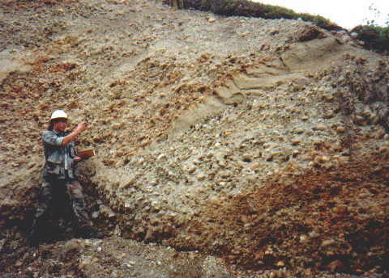
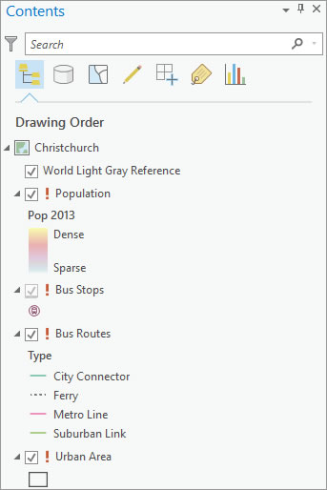
Coding 'decisions' in geospatial applications
IF slope >= 15 THEN
SET grade to steep
ENDIF
IF soil type is top or fill THEN
SET soil_class to1
ELSE IF soil type is alluvium THEN
SET soil_class to 2
ELSE IF soil type is loess THEN
SET soil_class to 3
ELSE
SET soil_class to 4
ENDIF
IF data source is broken THEN
GET data's server
IF server is A THEN
SET path to Server1
ELSE
SET path to Server2
ENDIF
ENDIF
Decisions allow programs to make choices based on conditions.
Notes:
What are some ways you might use decision-making for your geospatial workflows?
It might be as simple as setting the trail difficulty rating based on the change in elevation. For example, if the slope is greater than 15, set the grade to steep.
The geospatial forums are full of questions involving the logic for checking the value of one field to set the value of another field.
For example, you may need to set the soil classification number based on the soil type.
Data management is another common use of decision-making.
The third example is updating map layer sources based on their current data sources.
Decisions allow programs to make choices based on conditions
An expression that is either true or false, is referred to as a "condition" or a "Boolean expression".
The Boolean expression here is Slope > 15%
The bolded phrases in these three examples are the conditions.

Slide 3
Conditions
Decisions allow programs to make choices based on conditions.
IF slope >= 15 THEN
SET grade to steep
ENDIF
IF soil type is top or fill THEN
SET soil_class to1
ELSE IF soil type is alluvium THEN
SET soil_class to 2
ELSE IF soil type is loess THEN
SET soil_class to 3
ELSE
SET soil_class to 4
ENDIF
IF data source is broken THEN
GET data's server
IF server is A THEN
SET path to Server1
ELSE
SET path to Server2
ENDIF
ENDIF
A condition is also referred to as a Boolean expression
Boolean expression – a statement that is either true or false
The workflow will be behave differently depending on the conditions.
Notes:
Let's think about this statement "Decisions allow programs to make choices based on conditions"
A condition is also referred to as a Boolean expression.
Boolean expression – a statement that is either true or false.
The Boolean expression in the first example is "Slope >= 15%"
The bolded phrases in these three examples are the conditions.
The workflow will be behave differently depending on the truth values of these conditions.
These examples use pseudocode. Let's talk about how this looks in Python.

Slide 4

Conditional statement
Used to execute specific blocks of code based on certain conditions
if slope >= 15:
grade = "steep"
print(f"Trail slope: {slope}")
Notes:
In Python, you can use a conditional statement to execute a specific block of code based on certain conditions. This example, sets the trail grade to "steep" and prints the slope if the slope is at least 15 degrees.

Slide 5
Conditional statement
Used to execute specific blocks of code based on certain conditions
if slope >= 15:
grade = "steep"
print(f"Trail slope: {slope}")
Notes:
Here,
if slope >= 15:
is the conditional statement.

Slide 6
Conditional statement
Used to execute specific blocks of code based on certain conditions
if slope >= 15:
grade = "steep"
print(f"Trail slope: {slope}")
Notes:
The specific block of code being executed in this case are the 2nd and 3rd lines, setting grade to steep and printing the trail slope.

Slide 7
"if" statement
Basic format (syntax)
if condition:
# code to execute if condition is True
Example
grade = "gentle"
if slope >= 15:
grade = "steep"
print("Trail grade updated")
print(f"Final grade:{grade}")
Block of code
Notes:
An "if" statement is the simplest form of conditional statement.
The if keyword is followed by a condition (some expression that is evaluated as True or False), followed by a colon.
The block of code that will be executed if the condition is met, is indented one level.
Indentation defines the block of code. When the code is no longer indented, the conditional statement ends.
There is no endif in Python. Dedenting serves this purpose.
Thus, print(f"Final grade: {grade}") is NOT inside the conditional. This means the trail grade gets printed regardless of the condition's truth value.

Slide 8
"else" clause
Provide an alternative block of code to execute when condition is false.
Basic format (syntax)
if condition:
# code to execute if condition is True
else:
# code to execute if condition is False
Example
if slope >= 15:
grade = "steep"
else:
grade = "not steep"
print(f"Final grade:{grade}")
Block of code
Block of code
Notes:
An "if" statement is the simplest form of conditional statement.
The if keyword is followed by a condition (some expression that is evaluated as True or False), followed by a colon.
The block of code that will be executed if the condition is met, is indented one level.
Indentation defines the block of code. When the code is no longer indented, the conditional statement ends.
There is no endif in Python. Dedenting serves this purpose.
Thus, trail_list.append is NOT inside the conditional. This means the trail name gets appended to the trail list regardless of the condition's truth value.

Slide 9
"elif" clause
Short for "else if", clause for handling multiple conditions
Basic format (syntax)
if condition1:
# code to execute if condition1 is True
elif condition2:
# code to execute if condition1 is False and condition2 is True
Example
if slope >= 15:
grade = "steep"
elif slope >= 7:
grade = "moderate"
print(f"Final grade:{grade}")
Notes:
An "if" statement is the simplest form of conditional statement.
The if keyword is followed by a condition (some expression that is evaluated as True or False), followed by a colon.
The block of code that will be executed if the condition is met, is indented one level.
Indentation defines the block of code. When the code is no longer indented, the conditional statement ends.
There is no endif in Python. Dedenting serves this purpose.
Thus, trail_list.append is NOT inside the conditional. This means the trail name gets appended to the trail list regardless of the condition's truth value.

Slide 10
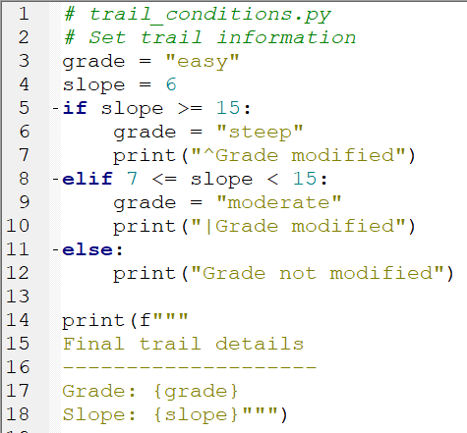
The anatomy of decision-making in Python
keywords if, elif, else
condition (Boolean expression)
slope >= 15
blocks of code
grade = "steep"
print("^Grade modified")
indentation –IDE helps
dedentation
colon
if slope >= 15:
Notes:
To dedent means the opposite of indent (dedent == move to the left one level)
The code shown in the image on this slide is as follows:
# trail_conditions.py # Set trail information grade = "easy" slope = 6 if slope >= 15: grade = "steep" print("^Grade modified") elif 7 <= slope < 15: grade = "moderate" print("|Grade modified") else: print("Grade not modified") print(f""" Final trail details -------------------- Grade: {grade} Slope: {slope}""")

Slide 11
Syntax for branching
if <condition 1>:
print("hi")
elif <condition 2>:
print("ho")
else: print("hey")
if <condition 1>:
print("hi")
else:
print("ho")
if <condition 1>:
print("hi")
Pop quiz
How many elif blocks of code can you have?
How many else blocks can go with each if block?
Is the else block required?
Which of these examples always prints something?
If conditional statement 1 is true, will all of these examples print something?
For the last box, give an example for conditional statements 1 and 2 so that ‘ho’ would never be printed.
if <conditional 1>:
print("hi")
elif <condition 2>:
print("ho")
Notes:
How many elif blocks of code can you have? sky’s the limit, but if you have many, there’s probably a better way to do it…(Google ‘Python dictionary’)
How many else blocks can go with each if block? at most one
Is the else block required? No
Which of these examples always print something? The first two.
If conditional statement 1 is true will all of these examples print something? Yes, they’ll all print ‘hi’
Give an example for conditional statements 1 and 2 so that ‘ho’ would never be printed. cs1: x < 10 cs2: x < 9

Slide 12
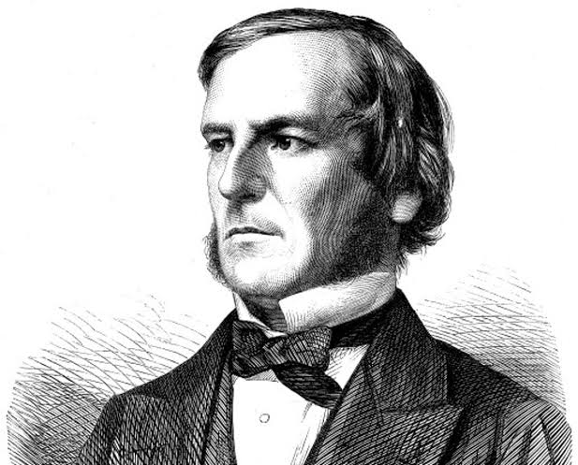
Boolean logic for decision-making
Boolean expression: Expression that is either True or False.
Mathematician, George Boole, 1815-1864
Notes:
Boolean logic, conceived by George Boole, is considered to as foundation for the information age. Boolean logic is a type of algebra in which all expressions are calculated as either true or false. All aspects of computing, from your ArcGIS Project files to your Google directions to the convenience store, at the very core, are based on combinations of binary values. This video will familiarize you with logic concepts you need to automate decision-making in geospatial applications.

Slide 13


Boolean in Python
bool (Stands for Boolean)
1) A data type
Built-in constants True and False are the only values of this data type.
2) A built-in function
Returns True or False for a given expression.
Notes:
In Python bool, which stands for Boolean, is two things.
A data type. Built-in constants True and False are the only values of this data type.
A built-in function. Returns True or False for a given expression.

Slide 14

bool function
The bool function casts the input expression to Boolean (True or False).
bool(x) returns True when the argument x is true, False otherwise.
>>> num = 5
>>> bool(num > 4)
True
>>> bool(num)
True
>>> my_list = []
>>> bool(my_list)
False
Notes:
The bool function casts the input expression to Boolean. Since the only value that a Boolean can have is True or False, it either returns True or False.
import sys
x = 5
bool(x <= 0 or x >= 10)
ssn = "123-45-6789"
bool(not ssn.isalpha())
import os
out_dir = "C:/temp"
if not os.path.exists("C:/temp"):
os.mkdir(out_dir)
my_files = os.listdir(out_dir)
if not my_files:
print(f"{out_dir} is empty.")
if 20 < weight < 40 and 3 <= age <= 5:
seat = "booster"
x = 5
y = 6
bool(x >= y)
my_list = []
bool(my_list)
place = "Hawaii"
bool(place)
bool("ha" in place.lower() or "ba" in place.lower())
country = "United States of America"
country.startswith("Un") and "State" in country

Slide 15
Built-in False Objects in Python
False
None
0
""
()
[]
{}
All other numbers, strings, lists, tuples, & dictionaries are True.

Slide 16
Truth testing with bool
The bool function can be used to test the truth value of an expression.
>>> place = "Hawaii"
>>> bool(place)
True
>>> my_list = []
>>> bool(my_list)
False
>>> x = 5
>>> y = 6
>>> bool(x != y)
True
>>> bool("ha" in place.lower() or "ba" in place.lower())
True
Notes:
The bool function casts
import sys
x = 5
bool(x <= 0 or x >= 10)
ssn = "123-45-6789"
bool(not ssn.isalpha())
import os
out_dir = "C:/temp"
if not os.path.exists("C:/temp"):
os.mkdir(out_dir)
my_files = os.listdir(out_dir)
if not my_files:
print(f"{out_dir} is empty.")
if 20 < weight < 40 and 3 <= age <= 5:
seat = "booster"
x = 5
y = 6
bool(x >= y)
my_list = []
bool(my_list)
place = "Hawaii"
bool(place)
bool("ha" in place.lower() or "ba" in place.lower())
country = "United States of America"
country.startswith("Un") and "State" in country

Slide 17
Operators
The bool function casts the input to Boolean.
>>> place = "Hawaii"
>>> bool(place)
True
>>> my_list = []
>>> bool(my_list)
False
>>> x = 5
>>> y = 6
>>> bool(x != y)
True
>>> bool("ha" in place.lower() or "ba" in place.lower())
True
Comparison operator
Logical operator
Notes:
The bool function casts
import sys
x = 5
bool(x <= 0 or x >= 10)
ssn = "123-45-6789"
bool(not ssn.isalpha())
import os
out_dir = "C:/temp"
if not os.path.exists("C:/temp"):
os.mkdir(out_dir)
my_files = os.listdir(out_dir)
if not my_files:
print(f"{out_dir} is empty.")
if 20 < weight < 40 and 3 <= age <= 5:
seat = "booster"
x = 5
y = 6
bool(x >= y)
my_list = []
bool(my_list)
place = "Hawaii"
bool(place)
bool("ha" in place.lower() or "ba" in place.lower())
country = "United States of America"
country.startswith("Un") and "State" in country

Slide 18
Composing Boolean expressions
Conditions can include comparison and logical operators.
Comparison operators >, <, <=,>=
!= not equal == equal
Logical operators and, or, and not
Notes:
Conditions can include any of these comparison and logical operators.

Slide 19
Comparison operators
>, <, <=,>=
!= not equal == equal
x > y # x is greater than y
x < y # x is less than y
x >= y # x is greater than or equal to y
x <= y # x is less than or equal to y
x != y # x is not equal to y
x == y # x is equal to y
Note: Assignment (=) versus comparison (==)
>>> x = 5 # assignment statement
>>> y = x
>>> y == x
True
>>> y = x + 1
>>> y == x # comparison statement
False
>>> print(y)
6
>>> print(x)
5
Notes:
Most Python comparison operators are already familiar from mathematics.

Slide 20
Ordering
>, <, <=,>=
These comparison operators use the ordering defined by Python.
Compare numbers with numbers. Numerical ordering ✓
Compare strings with strings. alpha characters use alphabetical ordering
But which is larger, "a" or "b"? How about "A" versus "a"?
>>> bool("a" < "b")
True
>>> bool("A" > "a")
False
String ordering works from left to right until a deference is detected.
>>> bool("Geographic Info Science" < "Geographic Info Systems")
True
>>> bool("19" < "128")
False

Slide 21


Comparing num vs strings
In Python 3, there is no ordering defined between numbers and strings.
>>> bool(1 < "a")
TypeError: '<' not supported between instances of 'int' and 'str'
You can check for equality...
>>> bool(1 == "a")
False
...or inequality between numbers and strings.
>>> bool(1 != "a")
True
number
>, <, <=,>=
string
==, !=
number
string

Slide 22
Comparison gotcha
# getlat.py
import sys
lat = sys.argv[1]
if lat > 180:
print("Please enter a valid latitude.")
TypeError: '<' not supported between instances of 'str' and 'str'
--------------------------------------------------------------
# getlat_corrected.py
import sys
lat = float(sys.argv[1])
if lat > 180:
print("Please enter a valid latitude.")
When getting numerical user arguments, it's usually best to cast them immediately, at the variable assignment, and only store them as numbers.

Slide 23
Common comparison operator mistakes
Python
Not Python
<=
>=
!=
Backwards
=>
=<
=!
Can't type this
≤
≥
≠
SQL, not Python
<>

Slide 24
Logical Operators
and, or, not
>>> country = "United States of America"
>>> bool(country.startswith("Un") and "State" in country) True
>>> x = 5
>>> bool(x <= 0 or x >= 10)
False
>>> ssn = "123-45-6789"
>>> bool(not ssn.isalpha())
True
Notes:
------------------------------------------------------------
DEMO2: LOGICAL OPERATORS, BOOLEAN EXPRESSIONS and ASSIGNMENT
************************************************************
>>> 5==5
True
>>> 5>0
True
>>> 5<-10
False
>>> s1=''
>>> s2=' '
>>> s1 != s2
True
>>> x = 5
>>> x>0 and x<10
True
>>> 0<x<10
True
>>> True + False + 10
11
>>> False == 0
True
>>> False == 1
False
>>> 'alpha'> 'beta'
False

Slide 25
Logical operators for compound expressions
and, or, not
>>> country = "United States of America"
>>> bool(country.startswith("Un") and "State" in country) True
>>> x = 5
>>> bool(x <= 0 or x >= 10)
False
>>> ssn = "123-45-6789"
>>> bool(not ssn.isalpha() and not len(ssn) > 11)
True
Notes:
------------------------------------------------------------
DEMO2: LOGICAL OPERATORS, BOOLEAN EXPRESSIONS and ASSIGNMENT
************************************************************
>>> 5==5
True
>>> 5>0
True
>>> 5<-10
False
>>> s1=''
>>> s2=' '
>>> s1 != s2
True
>>> x = 5
>>> x>0 and x<10
True
>>> 0<x<10
True
>>> True + False + 10
11
>>> False == 0
True
>>> False == 1
False
>>> 'alpha'> 'beta'
False

Slide 26
Chaining comparison to replace 'and'
0 10
>>> x = 3
>>> (x > 0) and (x <= 10)
True
>>> 0 < x <= 10
True
>>> (x < 0) or (x >= 10)
False
Equivalent
0 10
Notes:
------------------------------------------------------------
DEMO2: LOGICAL OPERATORS, BOOLEAN EXPRESSIONS and ASSIGNMENT
************************************************************
>>> 5==5
True
>>> 5>0
True
>>> 5<-10
False
>>> s1=''
>>> s2=' '
>>> s1 != s2
True
>>> x = 5
>>> x>0 and x<10
True
>>> 0<x<10
True
>>> True + False + 10
11
>>> False == 0
True
>>> False == 1
False
>>> 'alpha'> 'beta'
False

Slide 27
Using operators in conditions
You are using code to collect the vowels and hashtags into a list. Right now, you have a character, char, and you need to decide whether or not to put it in the list.
vowels = ["a", "e", "i", "o", "u"]
if char in vowels or char == "#":
vowel_hash_list.append(char)
A restaurant provides booster seats and high-chairs for childing. As the waiter, you're need to assess which one to bring for a family with a small child. The rules state that children who way 20 to 40 pounds and are aged 3 to 5 can use a booster seat. If the child is less than 3 years old, you should bring a high chair. Write code to set seat to booster or high chair. Assume you have weight and age variables.
if 20 < weight < 40 and 3 <= age <= 5:
seat = "booster"
elif age < 3:
seat = "high chair"
Notes:
------------------------------------------------------------
DEMO2: LOGICAL OPERATORS, BOOLEAN EXPRESSIONS and ASSIGNMENT
************************************************************
>>> 5==5
True
>>> 5>0
True
>>> 5<-10
False
>>> s1=''
>>> s2=' '
>>> s1 != s2
True
>>> x = 5
>>> x>0 and x<10
True
>>> 0<x<10
True
>>> True + False + 10
11
>>> False == 0
True
>>> False == 1
False
>>> 'alpha'> 'beta'
False

Slide 28
Using operators in conditions
You want to check if there are any files in the output directory, out_dir.
my_files = os.listdir(out_dir)
if not my_files:
print(f"{out_dir} is empty.")
You want to check if an output directory exists and if not, make the directory.
if not os.path.exists(out_dir):
os.mkdir(out_dir)
Notes:
------------------------------------------------------------
DEMO2: LOGICAL OPERATORS, BOOLEAN EXPRESSIONS and ASSIGNMENT
************************************************************
>>> 5==5
True
>>> 5>0
True
>>> 5<-10
False
>>> s1=''
>>> s2=' '
>>> s1 != s2
True
>>> x = 5
>>> x>0 and x<10
True
>>> 0<x<10
True
>>> True + False + 10
11
>>> False == 0
True
>>> False == 1
False
>>> 'alpha'> 'beta'
False

Slide 29
Using operators in conditions
vowels = ["a", "e", "i", "o", "u"]
if char in vowels or char == "#":
vowel_hash_list.append(char)
if 20 < weight < 40 and 3 <= age <= 5:
seat = "booster"
elif age < 3:
seat = "high chair"
my_files = os.listdir(out_dir)
if not my_files:
print(f"{out_dir} is empty.")
if not os.path.exists(out_dir):
os.mkdir(out_dir)
Notes:
------------------------------------------------------------
DEMO2: LOGICAL OPERATORS, BOOLEAN EXPRESSIONS and ASSIGNMENT
************************************************************
>>> 5==5
True
>>> 5>0
True
>>> 5<-10
False
>>> s1=''
>>> s2=' '
>>> s1 != s2
True
>>> x = 5
>>> x>0 and x<10
True
>>> 0<x<10
True
>>> True + False + 10
11
>>> False == 0
True
>>> False == 1
False
>>> 'alpha'> 'beta'
False

Slide 30
Using operators in conditions
vowels = ["a", "e", "i", "o", "u"]
if char in vowels or char == "#":
vowel_hash_list.append(char)
if 20 < weight < 40 and 3 <= age <= 5:
seat = "booster"
elif age < 3:
seat = "high chair"
my_files = os.listdir(out_dir)
if not my_files:
print(f"{out_dir} is empty.")
if not os.path.exists(out_dir):
os.mkdir(out_dir)
Notes:
------------------------------------------------------------
DEMO2: LOGICAL OPERATORS, BOOLEAN EXPRESSIONS and ASSIGNMENT
************************************************************
>>> 5==5
True
>>> 5>0
True
>>> 5<-10
False
>>> s1=''
>>> s2=' '
>>> s1 != s2
True
>>> x = 5
>>> x>0 and x<10
True
>>> 0<x<10
True
>>> True + False + 10
11
>>> False == 0
True
>>> False == 1
False
>>> 'alpha'> 'beta'
False

Slide 31

Take-aways
Conditional statements
Decision-making syntax
Boolean Expressions
Comparison operators
Logical operators
Take-aways
Notes:
Conditional statements are used to execute specific blocks of code based on certain conditions
Decision-making syntax uses if, elif, and ellse keywords, conditions, colons, and indentation
Bool function can be used for truth testing
Comparison operators can compare numbers or strings, but not numbers with strings
Logical operators and, or, not can be used to form compound expressions.

Slide 32
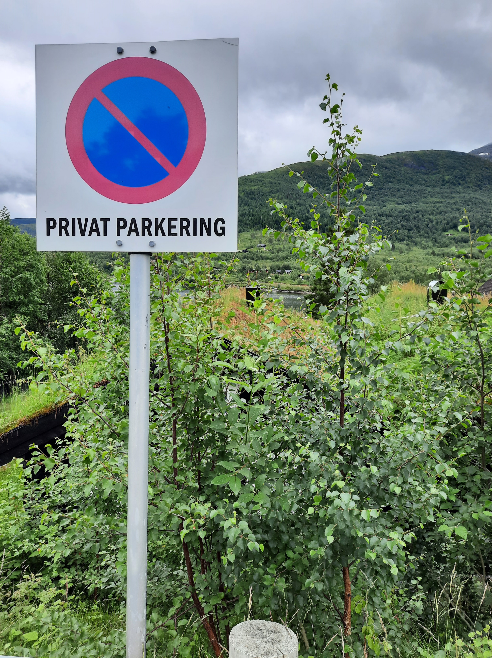
Common decision-making code mistakes
COMMON MISTAKES
Praemonitus, Praemunitus
–Forewarned is forearmed.
Notes:
Decision-making workflows are powerful, but they can often introduce mistakes into the code. As the saying goes, forewarned is forearmed, so let's arm ourselves by reviewing with some coping techniques and exposure to common mistakes.

Slide 33
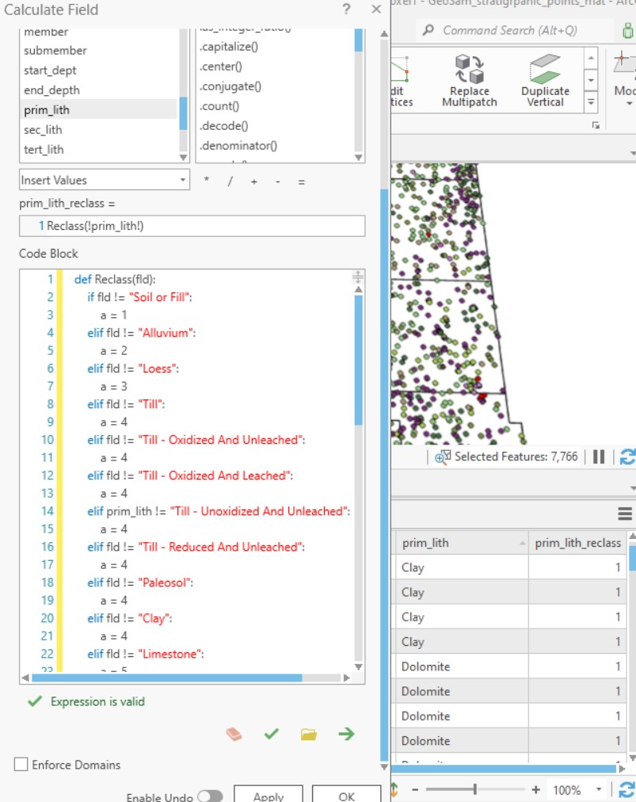
How to improve this decision-making code?
"I am trying to use a Python Code Block to use existing text field !prim_lith! (with geologic material descriptions, e.g., clay, sand) to populate a new integer field !prim_lith_reclass! whose value 1, 2, 3,...,9 depends on the geologic material in !prim_lith!."
(Anonymous Esri community member)
Notes:
First, take a look at this forum post. This person is trying to use Python in the calculate field tool, to use descriptive geological material names to set a numeric class field. Can you spot any ways you might improve this code? We'll come back to this again after looking through some issues.

Slide 34
Boolean Expression Review
Boolean expression: expression that is either True or False.
A conditional statement consists of Boolean expressions with logical and comparison operators.
Logical operators and, or, and not
Comparison operators
>, <, <=,>=
!= not equal == equal
False in Python:
False
None
0
""
()
[]
{}
All other numbers, strings,
lists, dictionaries, tuples
evaluate as True
Notes:
Frist, recall that we have logical and comparison operators. And that there are few values in Python that evaluate as False. The vast majority of values evaluate as True.

Slide 35
Meaning of and, or, and not
Truth table
--List all possible combinations of truth values (T or F) for logical expressions.
--Determine the resulting truth values (T or F) for each combination of inputs.
p and q represent independent logical statements. Examples of statements: slope > 15
That's my dog
The soil is clay Combining statements with logical operators
p: It's raining
q: Today is Friday
p and q
It's raining and today is Friday
p or q
It's raining or today is Friday
not p
It's not raining.
p | not p
T | F
F | T
p | q | p and q
T | T | T
F | T | F
T | F | F
F | F | F
p | q | p or q
T | T | T
F | T | T
T | F | T
F | F | F
Notes:
For those logical operators, familiarity with truth tables can be helpful.
Truth tables are an organized means for reasoning about logical statements.
To create a truth table, you list all the possible combinations of T or F values for logical expresssionsl
Then you determine the truth values of compound statements for each of these combinations.
For simplicity, the tables usually use letters such as p, q, and r to represent logical statements.
For example, a statement, p, could be ... slope > 15 , or It's raining, or, Today is Friday
Say p is it's raining and q is Today is Friday. Then p and q means, it's raining and today is Friday. .... you can make a truth table for p and q

Slide 36
Testing the branches
Aim to cover all possible branches of your decision-making statements. Test cases should include inputs that make the condition true,
inputs that make it false,
inputs that are on the boundary of the conditions.
For example, you want #'s between 0 and 10, test with values like -1, 0, 1, 10, and 11.
For each test case, define what the expected outcome should be. This could be a specific result, an error message, or no action at all.
x
0 10
Test | -1 | 0 | 1 | 10 | 11
Expected outcome | No | No | Yes | Yes | No

Slide 37
Common mistake: 'Or' instead of 'and'
0 10
>>> x = 3
>>> (x > 0) or (x <= 10)
True
>>> (x > 0) and (x <= 10)
True
>>> 0 < x <= 10
True
Test | -1 | 0 | 1 | 10 | 11
Expected outcome | No | No | Yes | Yes | No
Use 'and' to require two things
Notes:
------------------------------------------------------------
DEMO2: LOGICAL OPERATORS, BOOLEAN EXPRESSIONS and ASSIGNMENT
************************************************************
>>> 5==5
True
>>> 5>0
True
>>> 5<-10
False
>>> s1=''
>>> s2=' '
>>> s1 != s2
True
>>> x = 5
>>> x>0 and x<10
True
>>> 0<x<10
True
>>> True + False + 10
11
>>> False == 0
True
>>> False == 1
False
>>> 'alpha'> 'beta'
False

Slide 38
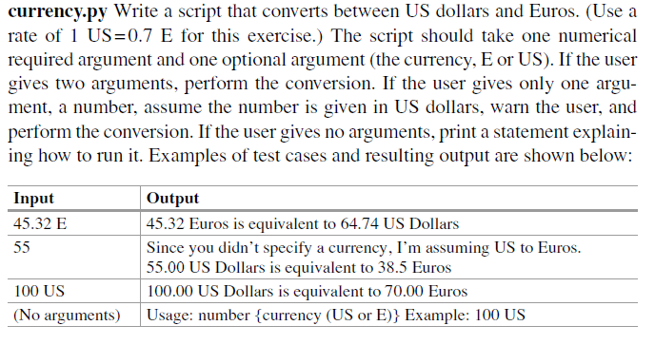


















Test and Expected outcomes
Test cases
Expected outcomes
Notes:
------------------------------------------------------------
DEMO2: LOGICAL OPERATORS, BOOLEAN EXPRESSIONS and ASSIGNMENT
************************************************************
>>> 5==5
True
>>> 5>0
True
>>> 5<-10
False
>>> s1=''
>>> s2=' '
>>> s1 != s2
True
>>> x = 5
>>> x>0 and x<10
True
>>> 0<x<10
True
>>> True + False + 10
11
>>> False == 0
True
>>> False == 1
False
>>> 'alpha'> 'beta'
False

Slide 39
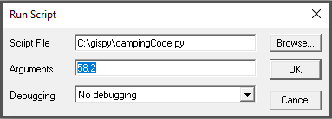
Common mistake: Apples & Oranges
Test | -1 | 40 | 58.2
Expected outcome | cancel | cancel | don't cancel
import sys
temperature = sys.argv[1]
if temperature <= 40: camping_trip = "cancelled"
---------------------------------------------------
import sys
temperature = float(sys.argv[1])
if temperature <= 40: camping_trip = "cancelled"
TypeError
Cast numbers at the outset.

Slide 40
Punctuation required
camping_trip = "proceed_as_scheduled"
if temperature <= 40 or temperature >= 90
camping_trip = "cancelled"
elif 60 <= temperature <= 78
camping_trip = "extended"
---------------------------------------------------
camping_trip = "proceed_as_scheduled"
if temperature <= 40 or temperature >= 90:
camping_trip = "cancelled"
elif 60 <= temperature <= 78:
camping_trip = "extended"
SyntaxError

Slide 41
Indentation required
camping_trip = "proceed_as_scheduled"
if temperature <= 40 or temperature >= 90:
camping_trip = "cancelled"
elif 60 <= temperature <= 78:
camping_trip = "extended"
---------------------------------------------------
camping_trip = "proceed_as_scheduled"
if temperature <= 40 or temperature >= 90:
camping_trip = "cancelled"
elif 60 <= temperature <= 78:
camping_trip = "extended"
SyntaxError

Slide 42
Common mistake:Over-condition-ing
if population <= 40_000:
size = 1
elif 40_000 < population <= 400_000:
size = 2
else population > 400_000:
size = 3
---------------------------------------------------
if population <= 40_000:
size = 1
elif 40_000 < population <= 400_000:
size = 2
else:
size = 3
SyntaxError
ELSE can't have a condition.

Slide 43
Common mistake: Over-if-ing
if population <= 40_000:
size = 1
if 40_000 < population <= 400_000:
size = 2
---------------------------------------------------
if population <= 40_000:
size = 1
elif 40_000 < population <= 400_000:
size = 2
Inefficient
Avoid redundant checks.

Slide 44
Common mistake: Over-elif-ing
if population <= 40_000:
size = 1
elif 40_000 < population <= 400_000:
size = 2
elif population > 400_000:
size = 3
---------------------------------------------------
if population <= 40_000:
size = 1
elif 40_000 < population <= 400_000:
size = 2
else:
size = 3
Inefficient
Avoid unnecessary checks.

Slide 45
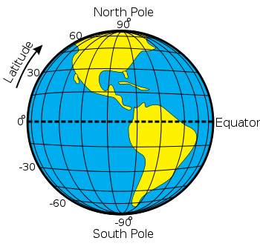
Use full statements
latitude <= 0
30 <= latitude <= 60
-60 <= latitude <= -30 or 30 <= latitude <= 60
latitude <-30 or latitude >= 30
latitude <-30 or >= 30
SyntaxError

Slide 46
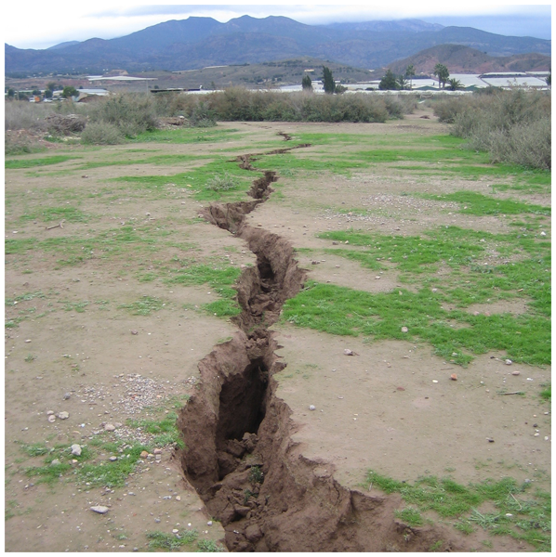
and, or fissure the expression
latitude <-30 or >=30
Use complete expressions on both the left and right of "or", "and"
operators
Image credit: https://piahs.copernicus.org/articles/382/663/2020/
Notes:
Image credit: https://piahs.copernicus.org/articles/382/663/2020/

Slide 47
Invalid incomplete expressions
camping_trip = "proceed_as_scheduled"
if temperature <= 40 or >= 90:
camping_trip = "cancelled"
elif 60 <= temperature and <= 78:
camping_trip = "extended"
---------------------------------------------------
camping_trip = "proceed_as_scheduled"
if temperature <= 40 or temperature >= 90:
camping_trip = "cancelled"
elif 60 <= temperature <= 78:
camping_trip = "extended"
SyntaxError

Slide 48
Valid but in complete expression
Statements must be complete on each side of operator.
Example: print when the species is salmon or tuna
if species == "salmon" or "tuna": print(species)
Test cases?
salmon
tuna
some other species
INCORRECT SOLUTION
>>> species = "salmon"
>>> if species == "salmon" or "tuna":
... print(species)
...
salmon
>>> species = "tuna"
>>> if species == "salmon" or "tuna":
... print(species)
...
tuna
>>> species = "pike"
>>> if species == "salmon" or "tuna":
... print(species)
...
pike
Test | salmon | tuna | pike
Expected outcome | Print | Print | Don't print
Notes:
------------------------------------------------------------
DEMO2: LOGICAL OPERATORS, BOOLEAN EXPRESSIONS and ASSIGNMENT
************************************************************
>>> 5==5
True
>>> 5>0
True
>>> 5<-10
False
>>> s1=''
>>> s2=' '
>>> s1 != s2
True
>>> x = 5
>>> x>0 and x<10
True
>>> 0<x<10
True
>>> True + False + 10
11
>>> False == 0
True
>>> False == 1
False
>>> 'alpha'> 'beta'
False

Slide 49
Valid but in complete expression
Test | salmon | tuna | pike
Expected outcome | Print | Print | Don't print
Statements must be complete on each side of operator.
Example: print when the species is salmon or tuna
if species == "salmon" or "tuna": print(species)
if species == "salmon" or species == "tuna": print(species)
INCORRECT SOLUTION
true…
so the entire statement is always true
CORRECT SOLUTION
Notes:
------------------------------------------------------------
DEMO2: LOGICAL OPERATORS, BOOLEAN EXPRESSIONS and ASSIGNMENT
************************************************************
>>> 5==5
True
>>> 5>0
True
>>> 5<-10
False
>>> s1=''
>>> s2=' '
>>> s1 != s2
True
>>> x = 5
>>> x>0 and x<10
True
>>> 0<x<10
True
>>> True + False + 10
11
>>> False == 0
True
>>> False == 1
False
>>> 'alpha'> 'beta'
False

Slide 50

Distributing negation
Beware of English language to logic statement conversions.
Example: Print the species if it’s not a trout or catfish.
if species != "trout" or "catfish":
print(species)
if species != "trout" or species != "catfish":
print(species)
if species != "trout" and species != "catfish":
print(species)
DeMorgan’s law: ~(p or q) ↔ ~p and ~q
Test | cod | trout | catfish
Expected outcome | Print | Don'tprint | Don't print
SOLUTION?
True all the time. If species is trout,...
the left side is False, but right side is True.
SOLUTION?
SOLUTION?
Notes:
DeMorgan’s law ~(p or q) ↔ ~p and ~q
------------------------------------------------------------
DEMO2: LOGICAL OPERATORS, BOOLEAN EXPRESSIONS and ASSIGNMENT
************************************************************
>>> 5==5
True
>>> 5>0
True
>>> 5<-10
False
>>> s1=''
>>> s2=' '
>>> s1 != s2
True
>>> x = 5
>>> x>0 and x<10
True
>>> 0<x<10
True
>>> True + False + 10
11
>>> False == 0
True
>>> False == 1
False
>>> 'alpha'> 'beta'
False

Slide 51
How to improve this decision-making code?
"I am trying to use a Python Code Block to use existing text field !prim_lith! (with geologic material descriptions, e.g., clay, sand) to populate a new integer field !prim_lith_reclass! whose value 1, 2, 3,...,9 depends on the geologic material in !prim_lith!."
(Anonymous Esri community member)
Notes:
def Reclass(fld): if fld=='soil or fill': return 1 elif fld=='alluvium': return 2 else: return 9
https://community.esri.com/t5/arcgis-pro-questions/calculate-field-helpers-reclassify-if-elif/m-p/1106085?search-action-id=84653597253&search-result-uid=1106085
I am trying to use Python / Code Block to use existing field !prim_lith! (text field, with geologic material descriptions, eg, clay, sand) to populate a new field !prim_lith_reclass! (short integer field) whose value 1, 2, 3,...9 depends on the geologic material in !prim_lith!. The Expression is valid and runs but the return values are all equal to 1 (from line 3 in the code block), see lower right of attached jpg. I've tried varied syntax etc. but nothing seems to work. Should text be in double quotes "text", or double apostrophe 'text' ? What is the difference between != and == ? Do I have to explicitly enter an Else?

Slide 52
2 ways to improve this decision-making code
replace != with ==
Example:
if fld == "Soil or Fill":
2. Handle a = 4 soils more efficiently
elif fld in ["Till", "Till-Oxidized and Unbleached", ... ,"Clay"]:
Notes:
def Reclass(fld): if fld=='soil or fill': return 1 elif fld=='alluvium': return 2 else: return 9
https://community.esri.com/t5/arcgis-pro-questions/calculate-field-helpers-reclassify-if-elif/m-p/1106085?search-action-id=84653597253&search-result-uid=1106085
I am trying to use Python / Code Block to use existing field !prim_lith! (text field, with geologic material descriptions, eg, clay, sand) to populate a new field !prim_lith_reclass! (short integer field) whose value 1, 2, 3,...9 depends on the geologic material in !prim_lith!. The Expression is valid and runs but the return values are all equal to 1 (from line 3 in the code block), see lower right of attached jpg. I've tried varied syntax etc. but nothing seems to work. Should text be in double quotes "text", or double apostrophe 'text' ? What is the difference between != and == ? Do I have to explicitly enter an Else?

Slide 53

Capturing the big picture
Avoid syntax & type errors
Use colons & indentation.
Cast numbers at the outset.
ELSE can't have a condition.
Use complete comparisons L/R.
Avoid logic errors
Use 'and' to require 2 conditions.
Use complete statements L/R.
Be efficient
Avoid redundant checking.
Use simple solutions.
Test against expected outcomes.
Debug

Slide 54
Appendix I

Slide 55

Truth tables

Slide 56
Truth tables for testing logic
p | q | p and q
T | T | T
F | T | F
T | F | F
F | F | F
Truth table
--List all possible combinations of truth values (T or F) for logical expressions.
--Determine the resulting truth values (T or F) for each combination of inputs.
p, q, and r represent Boolean expressions. slope > 15
It's raining
Today is Friday Combining statements with logical operators
p: It's raining
q: Today is Friday
p and q
It's raining and today is Friday
p or q
It's raining or today is Friday
nor p
It's not raining.
p | not p
T | F
F | T
p | q | p or q | not p
T | T | T | F
F | T | T | T
T | F | T | F
F | F | F | T
p | q | not p | (not p) and q
T | T | F | F
F | T | T | T
T | F | F | F
F | F | T | F
Notes:
A familiarity with introductory logic is helpful in writing well formed conditional code and debugging errors.

Slide 57
Truth tables
p: It's raining
q: Today is Friday
r: Traffic is heavy
(p or q) and r
It's raining or today is Friday, and traffic is heavy.
p | q | r | p or q | (p or q) and r
T | T | T | T | T
F | T | T | T | T
T | F | T | T | T
F | F | T | F | F
T | T | F | T | F
F | T | F | T | F
T | F | F | T | F
F | F | F | F | F

Slide 58
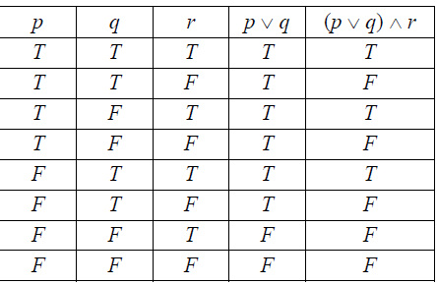
Truth tables usually use \/ for or /\ for and
The expression that goes behind the "if" or "elif" in Python is a Boolean expression (a statement which evaluates as True or False)
p, q, and r represent conditions. slope > 15
It's raining
Today is Friday
In truth tables, /\ represents and
\/ represents or
p: It's raining
q: Today is Friday
p /\ q: It's raining and today is Friday
(p \/ q) /\ r is a compound statement using a logical operator "or" to join p and q and a logical operator "and" to join (p \/ q) with r.
Notes:
A familiarity with introductory logic is helpful in writing well formed conditional code.

